Slide 1
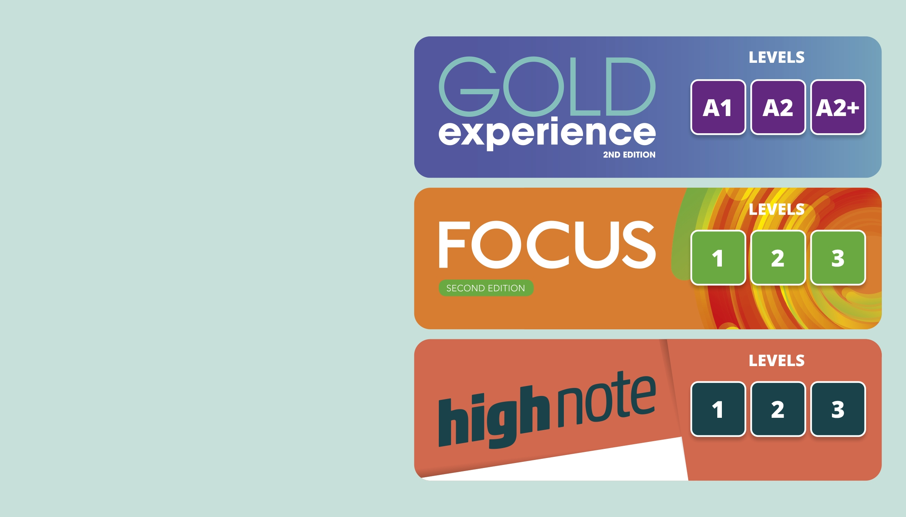
talking about the future

Slide 2
There are many ways we can talk about the future in English.
Let’s look at:
When and how we use going to.
When and how we use will.
When do we use going to, will ?

Slide 3


Function: When do we use them?
Next year, I’m going to look for a new hobby and I’m not going to get up very late. I think I’ll be a lot happier. What about you?
I’m going to travel more. I’m visiting my sister in New Zealand in March; I can’t wait! When are you going to start your new hobby?
An intention. She doesn’t have a specific date, but she has decided to do it.
I’m not sure, but definitely next year.
Look at what the girl says: ‘I think I’ll be happier’. Is this a fact or is it a prediction? Does she know for sure?
She doesn’t know for sure. It’s a prediction.
Look at what the girl says: ‘I’m going to look for a new hobby’. Is this an organised plan or an intention?
The future.
.

Slide 4

Function: When do we use them?
1. Going to for future intentions or things we have decided to do.
Next year, I’m going to look for a new hobby and I’m not going to get up very late.
I’m going to travel more.
There is no organised plan at the moment. There is no date or time.
2. Will for future predictions or things we think or know.
I think I’ll be a lot happier.
This is a prediction. The girl is not sure; it is just something she thinks.
We often use I think/
I don’t think before will.
How do we make sentences with going to?

Slide 5
Form: How do we use going to?
positive
subject |  | going to | verb infinitive
I | am | going to | travel.
He/She/It | is
You/We/They | are
negative
subject | to be | going to
I | am not (’m not) | going to | travel.
He/She/It | is not (isn’t)
You/We/They | aren’t (aren’t)
question
(qu. word + ) to be |  |  | verb infinitive
(Where) am | I | going to | eat?
(Where) is | she/he/it
(Where) are | you/we/they
?
?
short answer
Yes/No, |  | to be (+ or -)
Yes/No, | I | am/’m not.
 | he/she/it | is/isn’t.
 | you/we/they | are/aren’t.
?
?
subject

Slide 6
Form: How do we use going to?
positive
subject | to be | going to | verb infinitive
I | am | going to | travel.
He/She/It | is
You/We/They | are
negative
subject | to be | going to | verb infinitive
I | am not (‘m not) | going to | travel.
He/She/It | is not (isn’t)
You/We/They | aren’t (aren’t)
question
(qu. word + ) to be | subject | going to | verb infinitive
(Where) am | I | going to | eat?
(Where) is | she/he/it
(Where) are | you/we/they
short answer
Yes/No, | subject | to be (+ or -)
Yes/No, | I | am/’m not.
 | he/she/it | is/isn’t.
 | you/we/they | are/aren’t.
Here we invert the verb to be and the subject.

Slide 7
Form: How do we make sentences?
will
positive
subject | will | verb infinitive
I/You/He/She/It/We/They | will | go.
negative
subject | will not (won’t) | verb infinitive
I/You/He/She/It/We/They | will not/won’t | go.
question
(qu. word + ) will | subject |  | verb infinitive
(Where) will | I/you/he/she/it/we/they |  | go?
short answer
Yes/No, | subject | will/won’t
Yes/No, | I/you/he/ she/it/we/ they | will/won’t.
Look at the short answers for will.
Let’s practise!

Slide 8
Be going to | Will
UŻYCIE: -gdy mówimy o planach (plans) i zamiarach (intentions) na przyszłość: We’ve decided that we are going to start learning English. - możemy też użyć be going to, gdy przewidujemy przyszłość, ALE na podstawie oznak i przesłanek widocznych w momencie mówienia: Look at the sky!It is going to rain. | UŻYCIE: - gdy przewidujemy, często, aby wyrazić nasze zdanie odnośnie przyszłości: I think I will (I’ll) … I will (I’ll) probably.. I will definitely… I hope I will.. I expect I will… I imagine I will… I think he will finish the test on time. I hope tigers won’t (will not) die out. A lot of things will change. Gdy podejmujemy decyzję w momencie mówienia: It’s hot in here. -I will open the window. Gdy mówimy o wydarzeniach z przyszłości, które są prawdziwe: It’s my birthday tomorrow. I’ll be 17.

